Slide 1
February 10 Update
Like in january but a month later

Slide 2
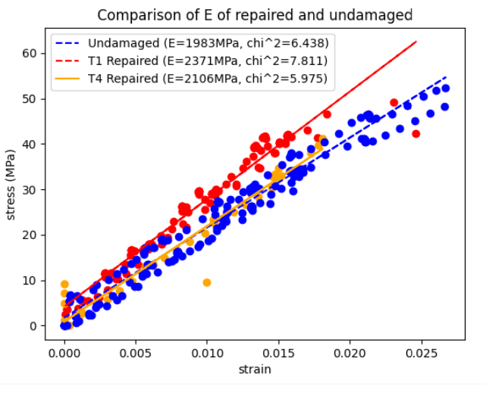
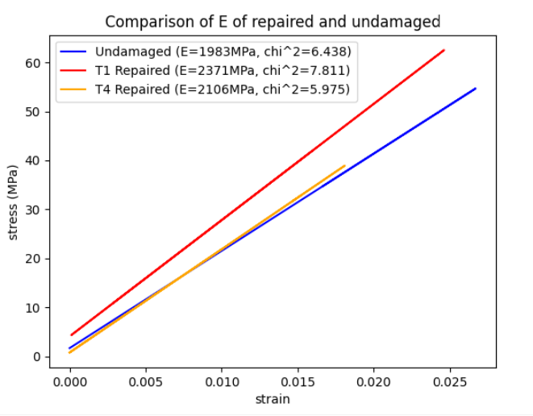
Testing Data, Young’s Modulus
Note: Only 1 T4 repaired sample. But looks consistent

Slide 3
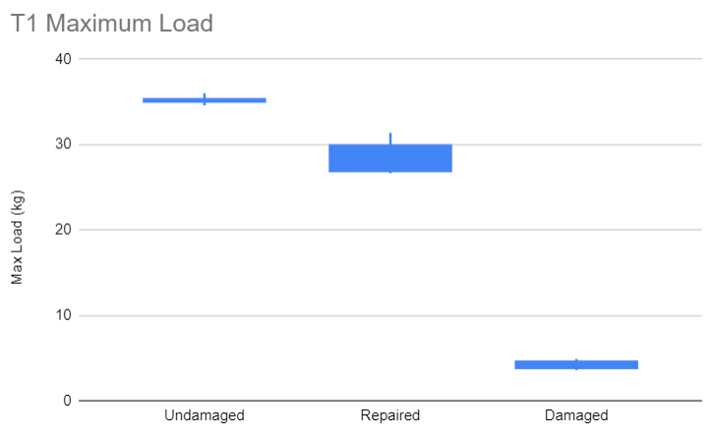
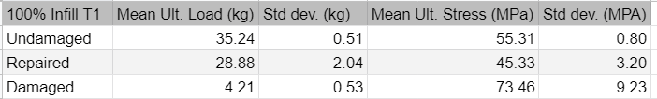
T1 Max Load

Slide 4
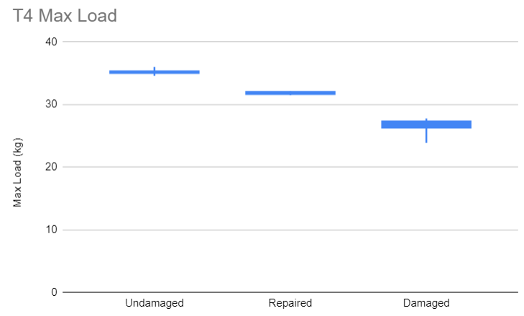
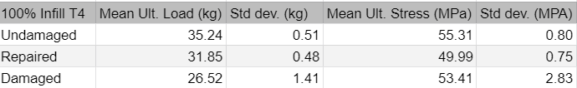
T4 Max Load

Slide 5
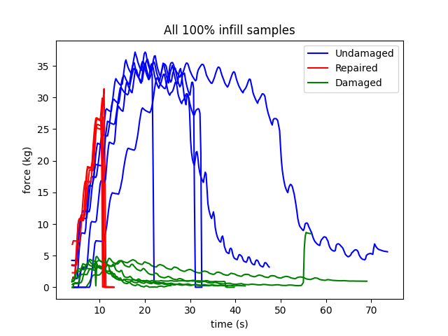
Testing Data

Slide 6
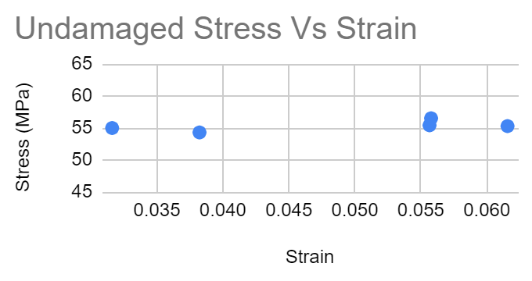
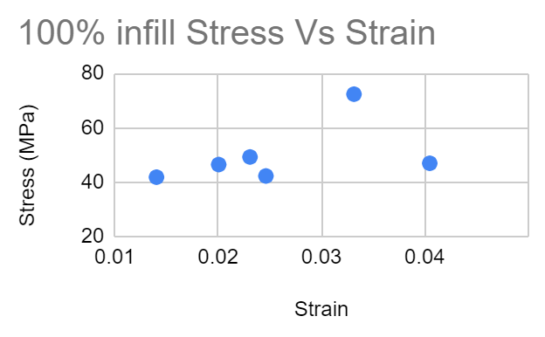
Testing Data
Stress data very consistent across parts at each infill
Strain data not consistent
Breaks before Ultimate Stress
Does not have a pattern for when it breaks

Slide 7
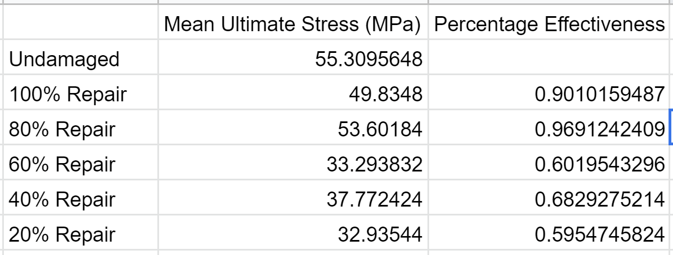
Testing Data
80% infill stronger than 100% infill
Notes:
“In the case of 80% infill density, result shows ductile behaviour. This may be due to the fact that there is a minor air gap between the beads and during tensile loading some beads filled this gap. Thus it gave more elongation as compared to specimen built with 100% infill density.”
https://journals.sagepub.com/doi/full/10.1177/0954406219856383

Slide 8
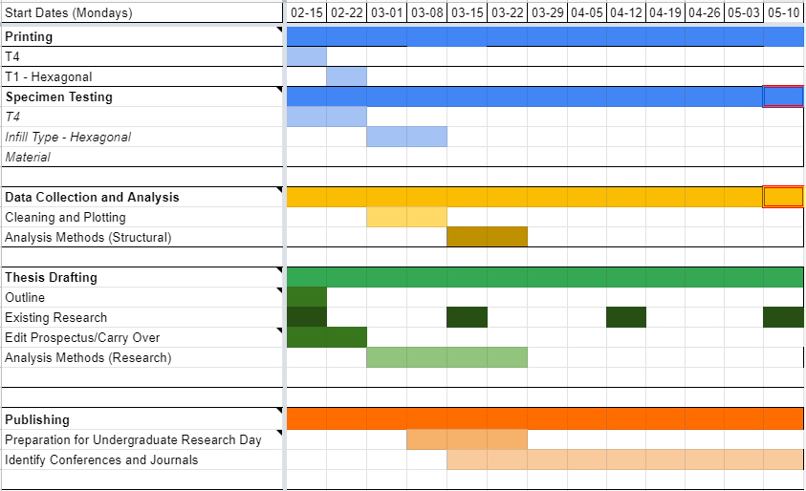
Semester Timeline

